Slide 1
The Otta Broker Portal
A tour of the portal brokers use to apply, track quotes and manage policies
FOR OTTA TEAM
Notes:
The Otta Broker Portal. A tour of the portal brokers use to apply, track quotes and manage policies.

Slide 2
What this module covers
1
Getting access
2
The dashboard
Signing in, requesting access and emailed sign-in links.
What brokers see first and how the menu works.
3
Forms and applications
4
Quotes, policies and help
Completing forms online, sending them to clients and tracking them.
Binding a quote, policies, documents and account settings.
Notes:
What this module covers. Getting access: Signing in, requesting access and emailed sign-in links. The dashboard: What brokers see first and how the menu works. Forms and applications: Completing forms online, sending them to clients and tracking them. Quotes, policies and help: Binding a quote, policies, documents and account settings.

Slide 3
Getting access
01
Brokers sign in with a password, an emailed link or their work account.
Notes:
Getting access. Brokers sign in with a password, an emailed link or their work account.

Slide 4
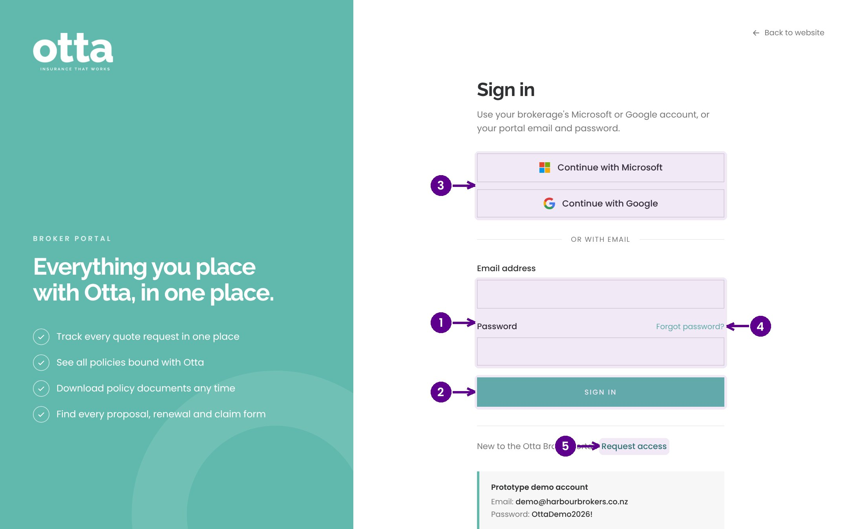
Signing in
1
Work email and password.
2
Select Sign in.
3
Or sign in with Microsoft or Google.
4
Forgotten your password? Email yourself a sign-in link.
5
New to Otta? Request access.
Notes:
This is the broker portal sign-in page. Brokers can use their email and password, their Microsoft or Google work account, or ask for a one-time sign-in link by email. Brokers who don't have an account yet select Request access.

Slide 5
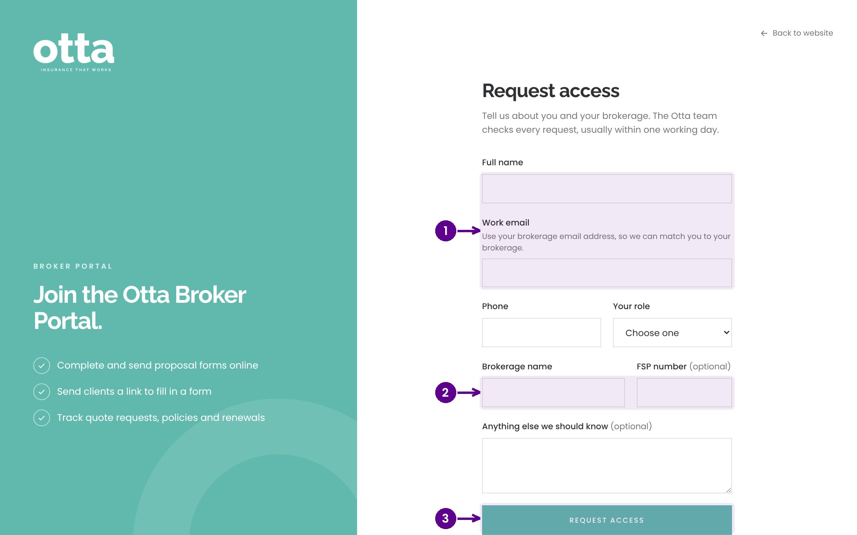
Requesting access
1
Name and work email.
2
Brokerage name and FSP number.
3
Request access. The Otta team checks it, usually within one working day.
Notes:
New brokers fill in this short form. The Otta team checks each request, usually within one working day, and the broker then gets a welcome email with a link to set their password.

Slide 6
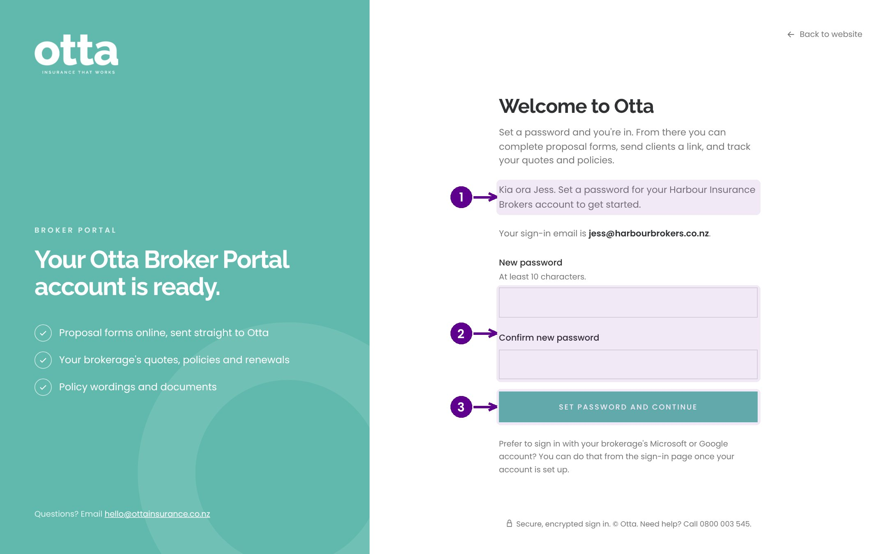
The welcome link
1
The welcome page, for the broker's new account.
2
Choose and confirm a password.
3
Set password and go straight into the portal.
Notes:
The welcome email links here. The broker chooses a password and goes straight into the portal. The link works for 7 days.

Slide 7
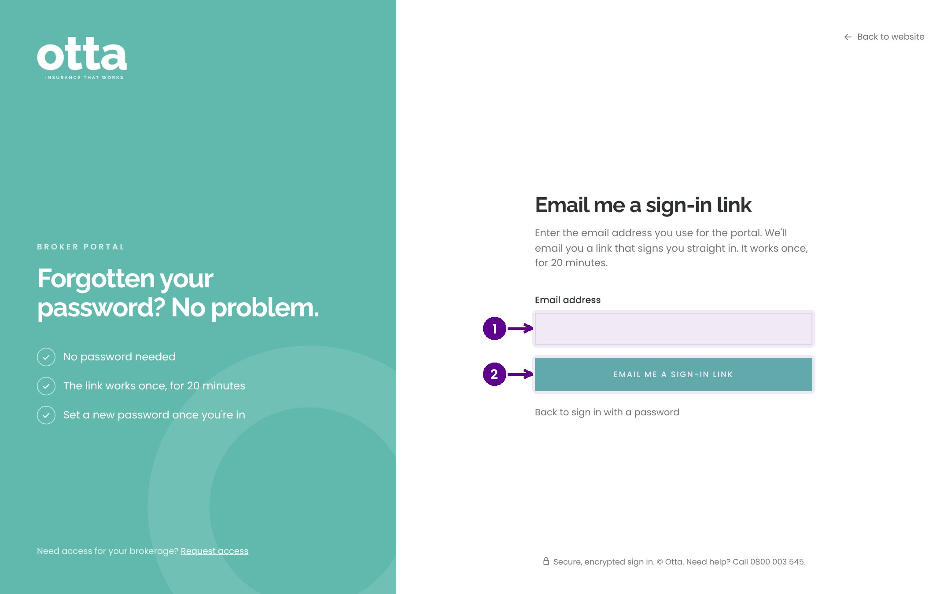
Emailed sign-in links
1
Enter the work email on the account.
2
Email me a sign-in link. It works once, for 20 minutes.
Notes:
If a broker forgets their password, they can ask for a sign-in link. It arrives by email, works once and lasts 20 minutes. Once in, they can set a new password from Your account.

Slide 8
The dashboard
02
Everything a broker has with Otta, on one page.
Notes:
The dashboard. Everything a broker has with Otta, on one page.

Slide 9
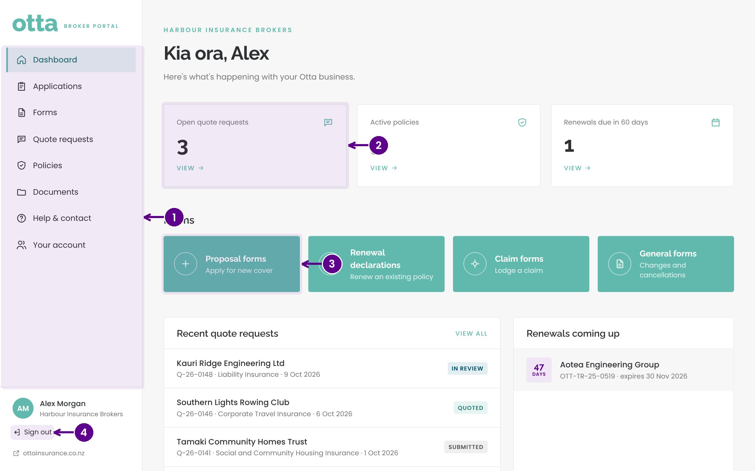
The dashboard
1
The menu: Dashboard, Applications, Forms, Quote requests, Policies, Documents, Help and Your account.
2
Open quote requests, active policies and renewals due. Select one to see the list.
3
Shortcuts to proposal forms, renewal declarations, claim forms and general forms.
4
Sign out.
Notes:
The dashboard greets the broker by name and shows their open quote requests, active policies and renewals due in the next 60 days. Shortcuts take them to the most used forms, and below are their recent quote requests and upcoming renewals.

Slide 10
Forms and applications
03
Brokers can complete a form themselves or send a secure link to their client.
Notes:
Forms and applications. Brokers can complete a form themselves or send a secure link to their client.

Slide 11
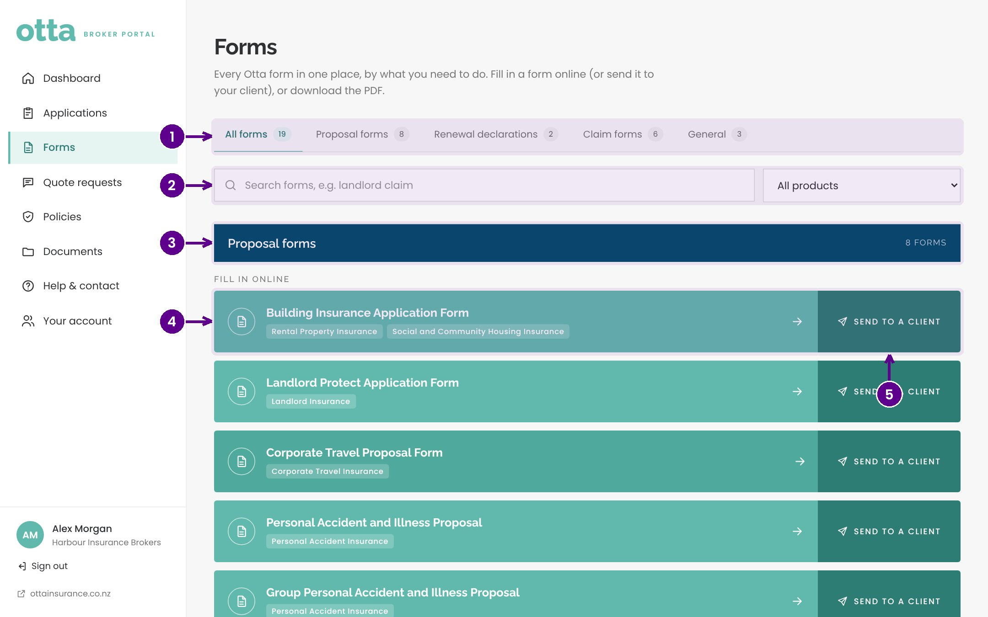
Forms
1
Choose the type: proposal forms, renewal declarations, claim forms or general forms.
2
Search by name or filter by product.
3
Forms are grouped under a banner for each product.
4
Select a form to complete it online.
5
Send to a client emails them a secure link instead.
Notes:
Forms holds every Otta form, grouped by product. Online forms appear first. Brokers can complete a form themselves, or send it to their client to fill in. Forms that are still PDF only can be downloaded.

Slide 12
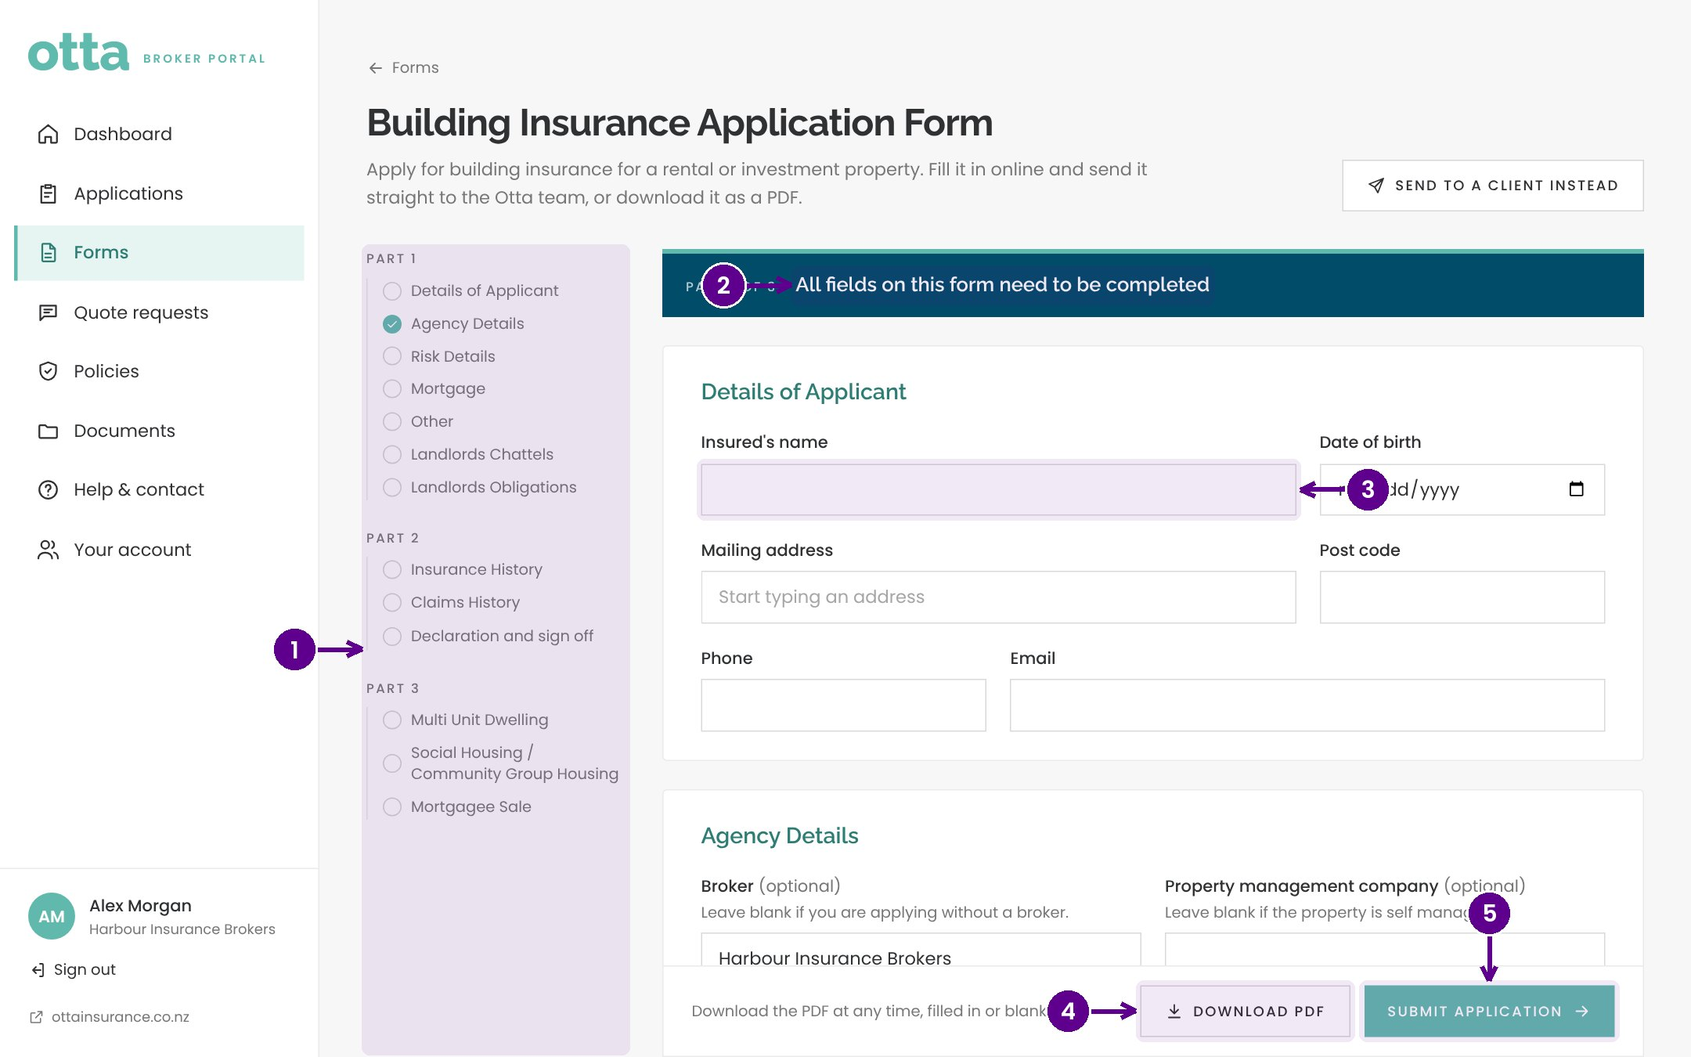
Completing a form online
1
The sections of the form. Jump to any section.
2
Each section is clearly headed.
3
Fill in the answers. Progress is kept as you go.
4
Download PDF saves a copy at any point.
5
Submit application sends it straight to Otta.
Notes:
Online forms are split into sections, with a contents list to jump around. Brokers can download a PDF copy at any point, and Submit sends the completed form straight to the right Otta team.

Slide 13
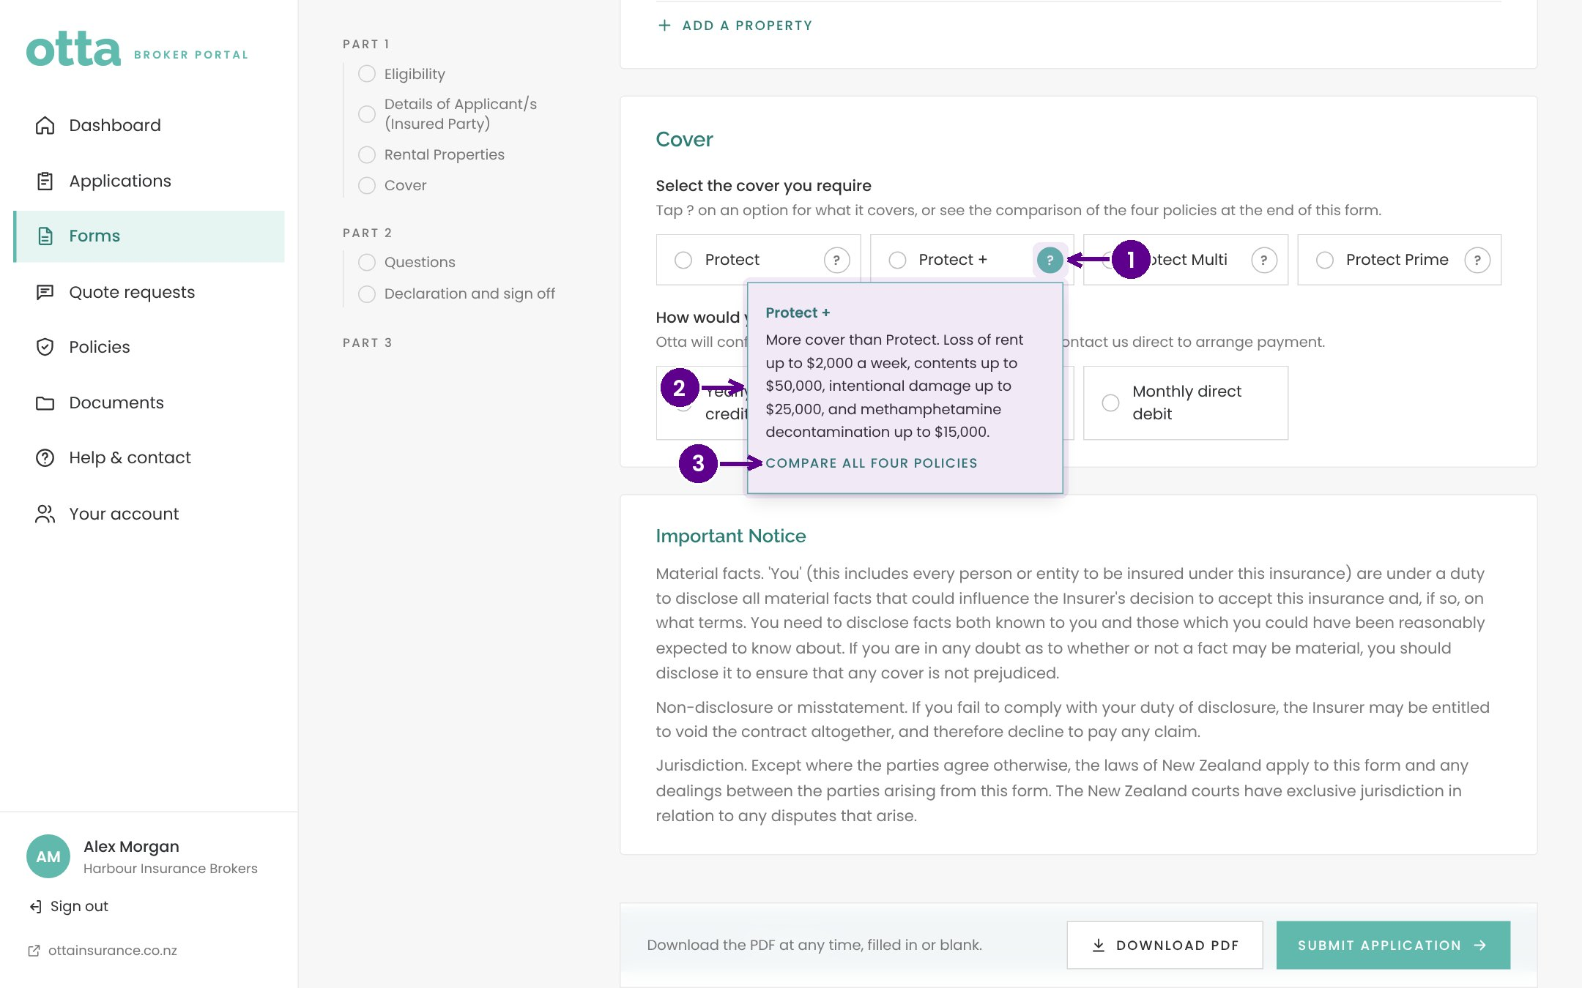
Help with cover options
1
Select the question mark beside a cover option.
2
A short explanation of what it covers.
3
A link to the policy wording for the detail.
Notes:
Where there are several cover options, such as on the Landlord Protect form, a question mark beside each one explains it briefly and links to the policy wording.

Slide 14
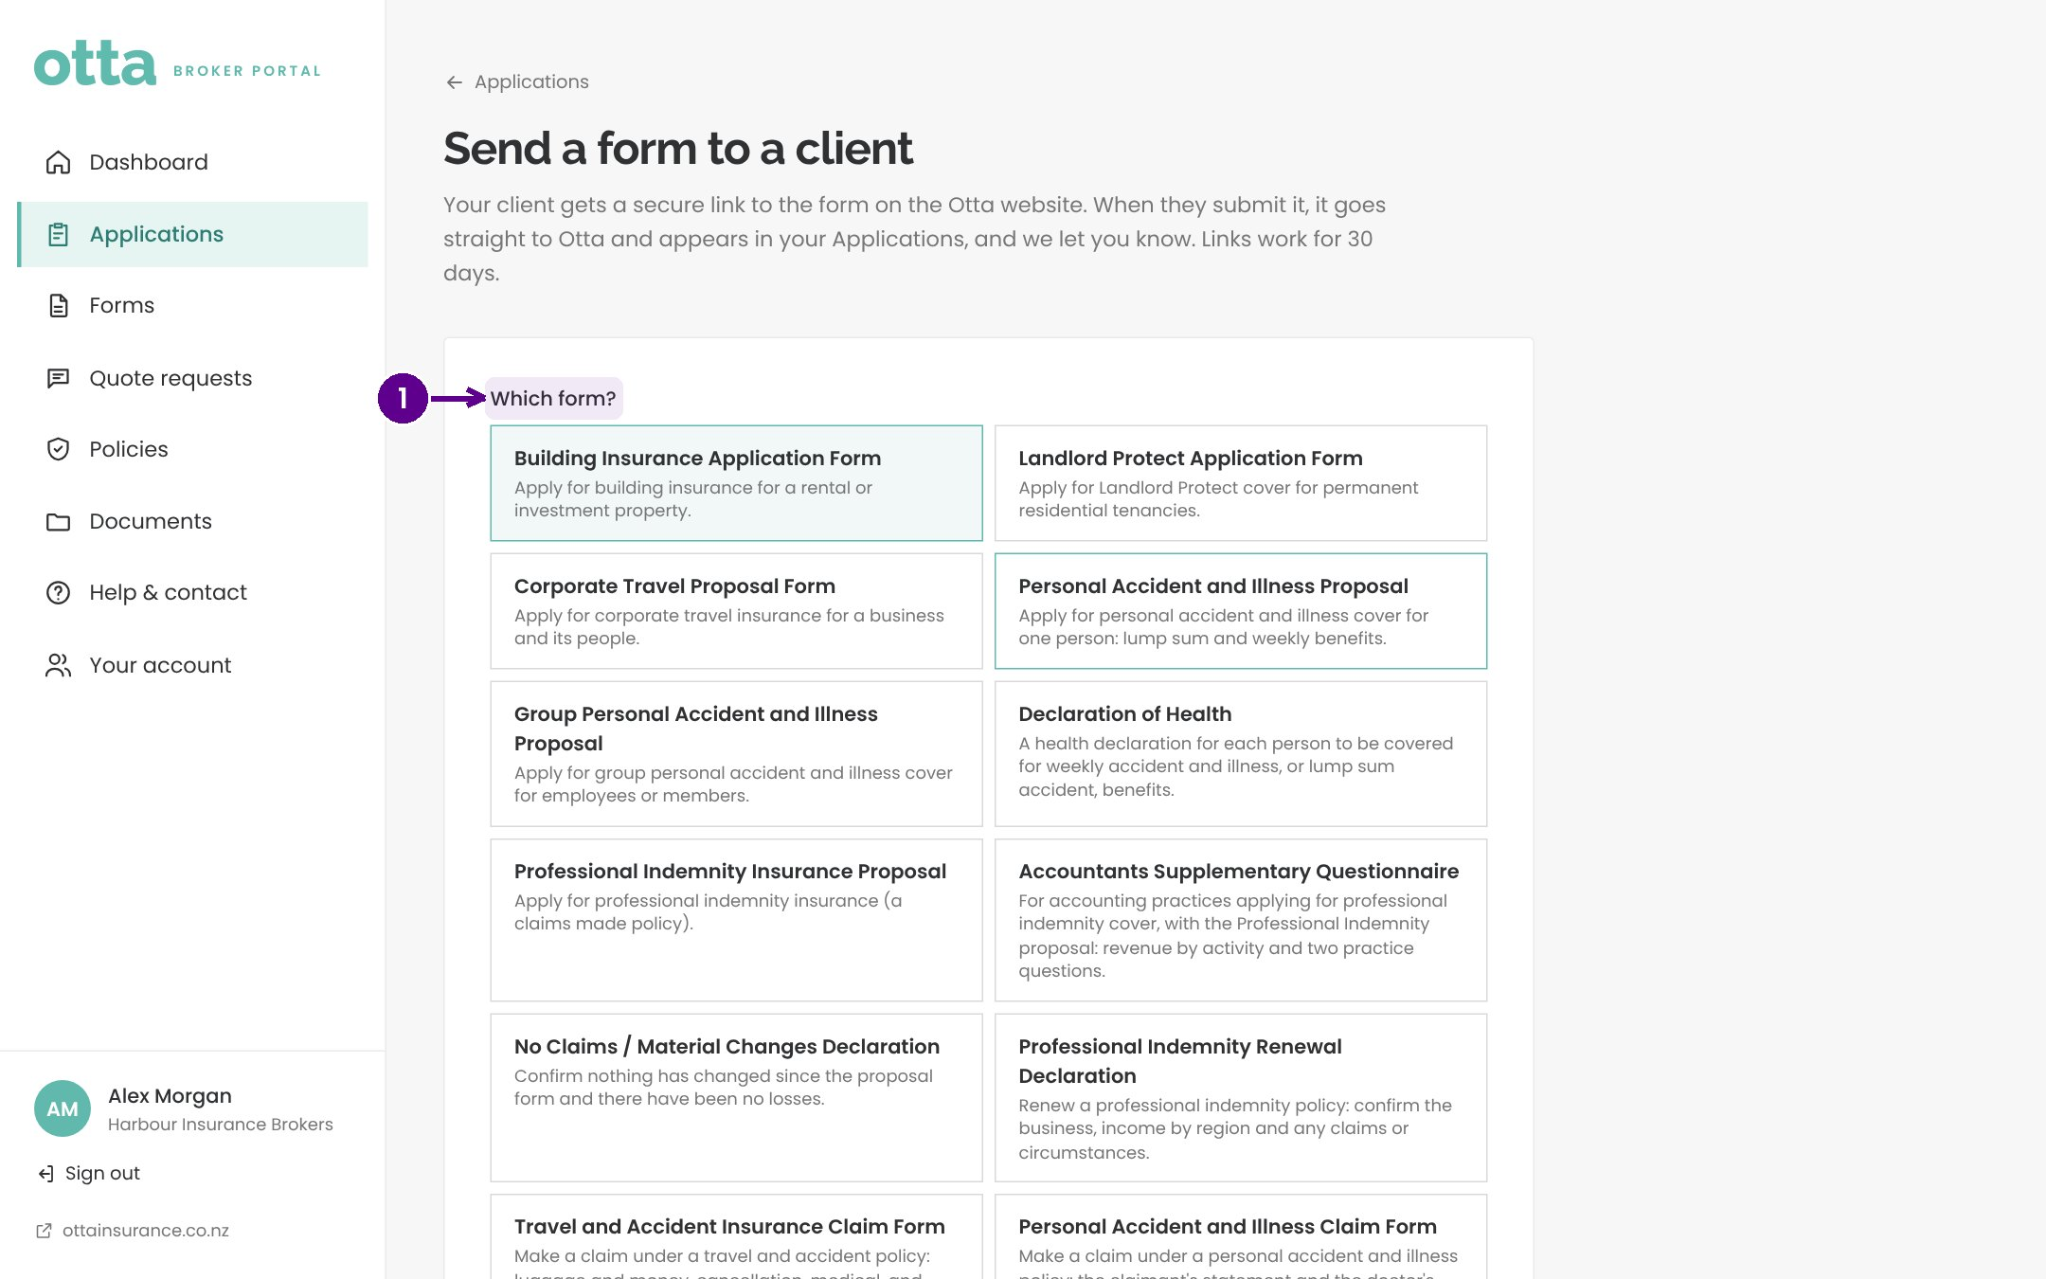
Sending a form to a client
1
Choose which form to send.
Notes:
To send a form to a client, choose the form first. The client gets a secure link to that form on the Otta website.

Slide 15
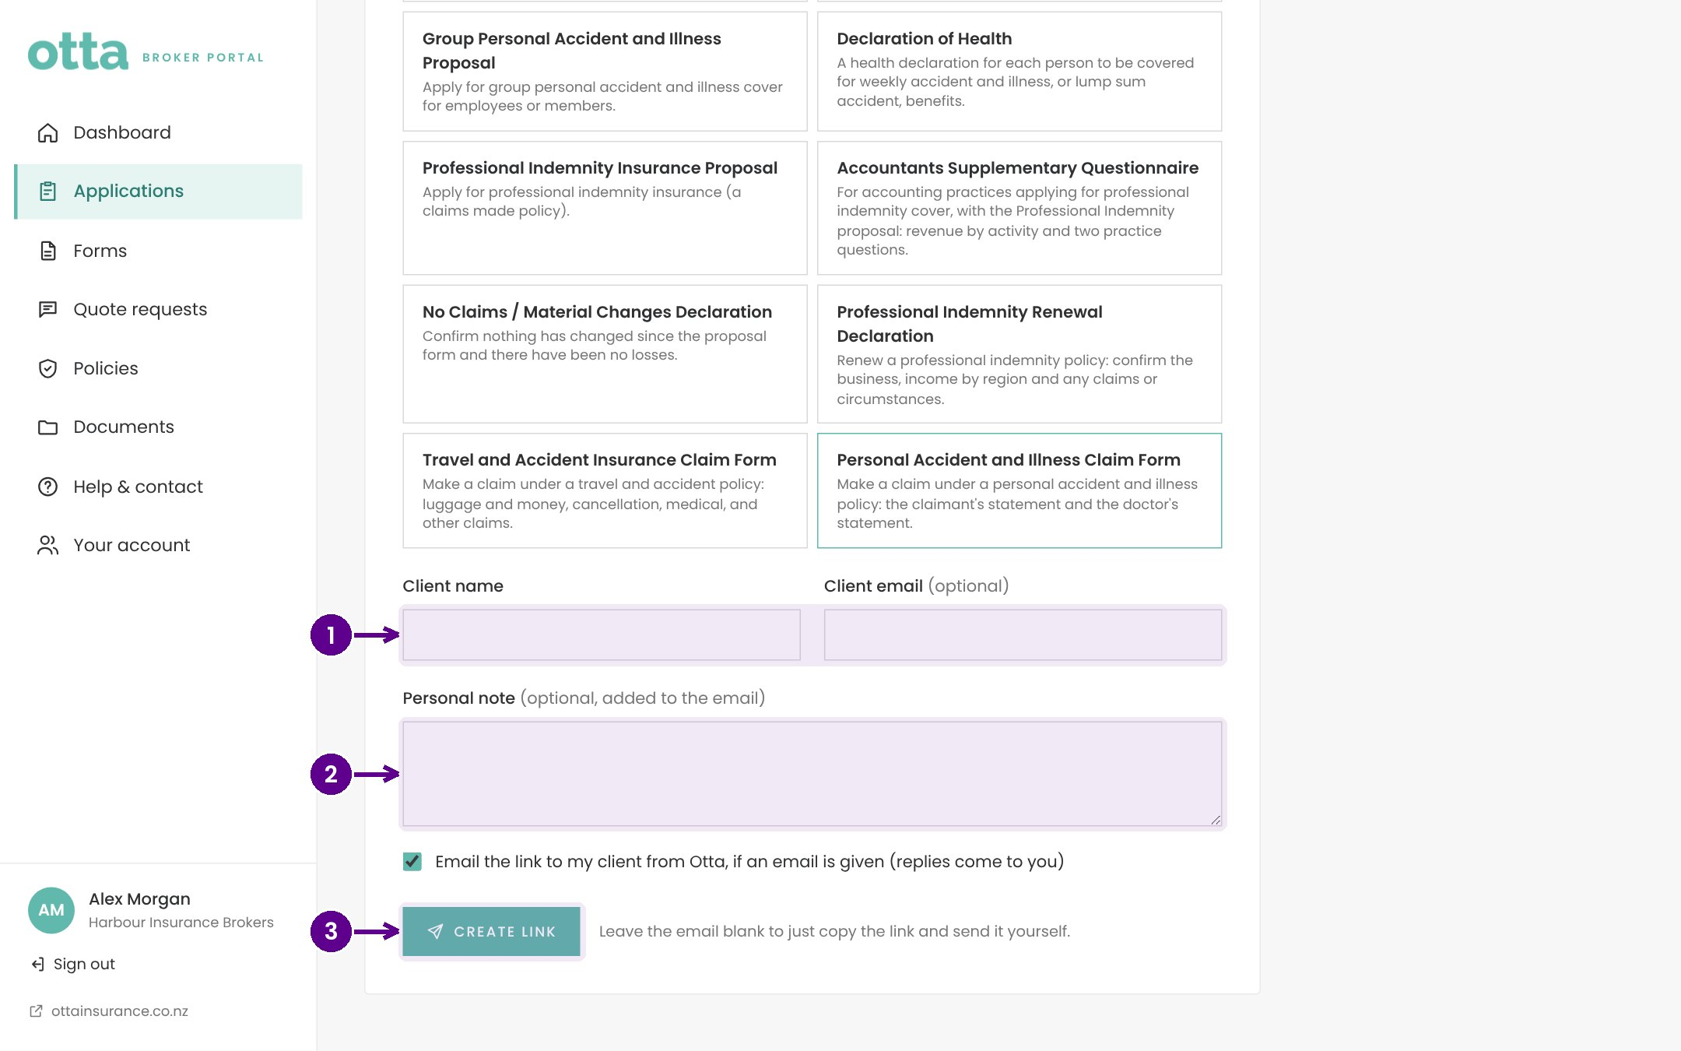
Sending a form to a client (continued)
1
The client's name and email.
2
An optional personal note for the email.
3
Create link. Otta emails it to the client, or copy it and send it yourself.
Notes:
Add the client's name and email, and a note if you like. Otta emails the link for you, with replies coming back to you. Leave the email blank to just copy the link. Links work for 30 days, and when the client submits, it goes straight to Otta and appears in your Applications.

Slide 16
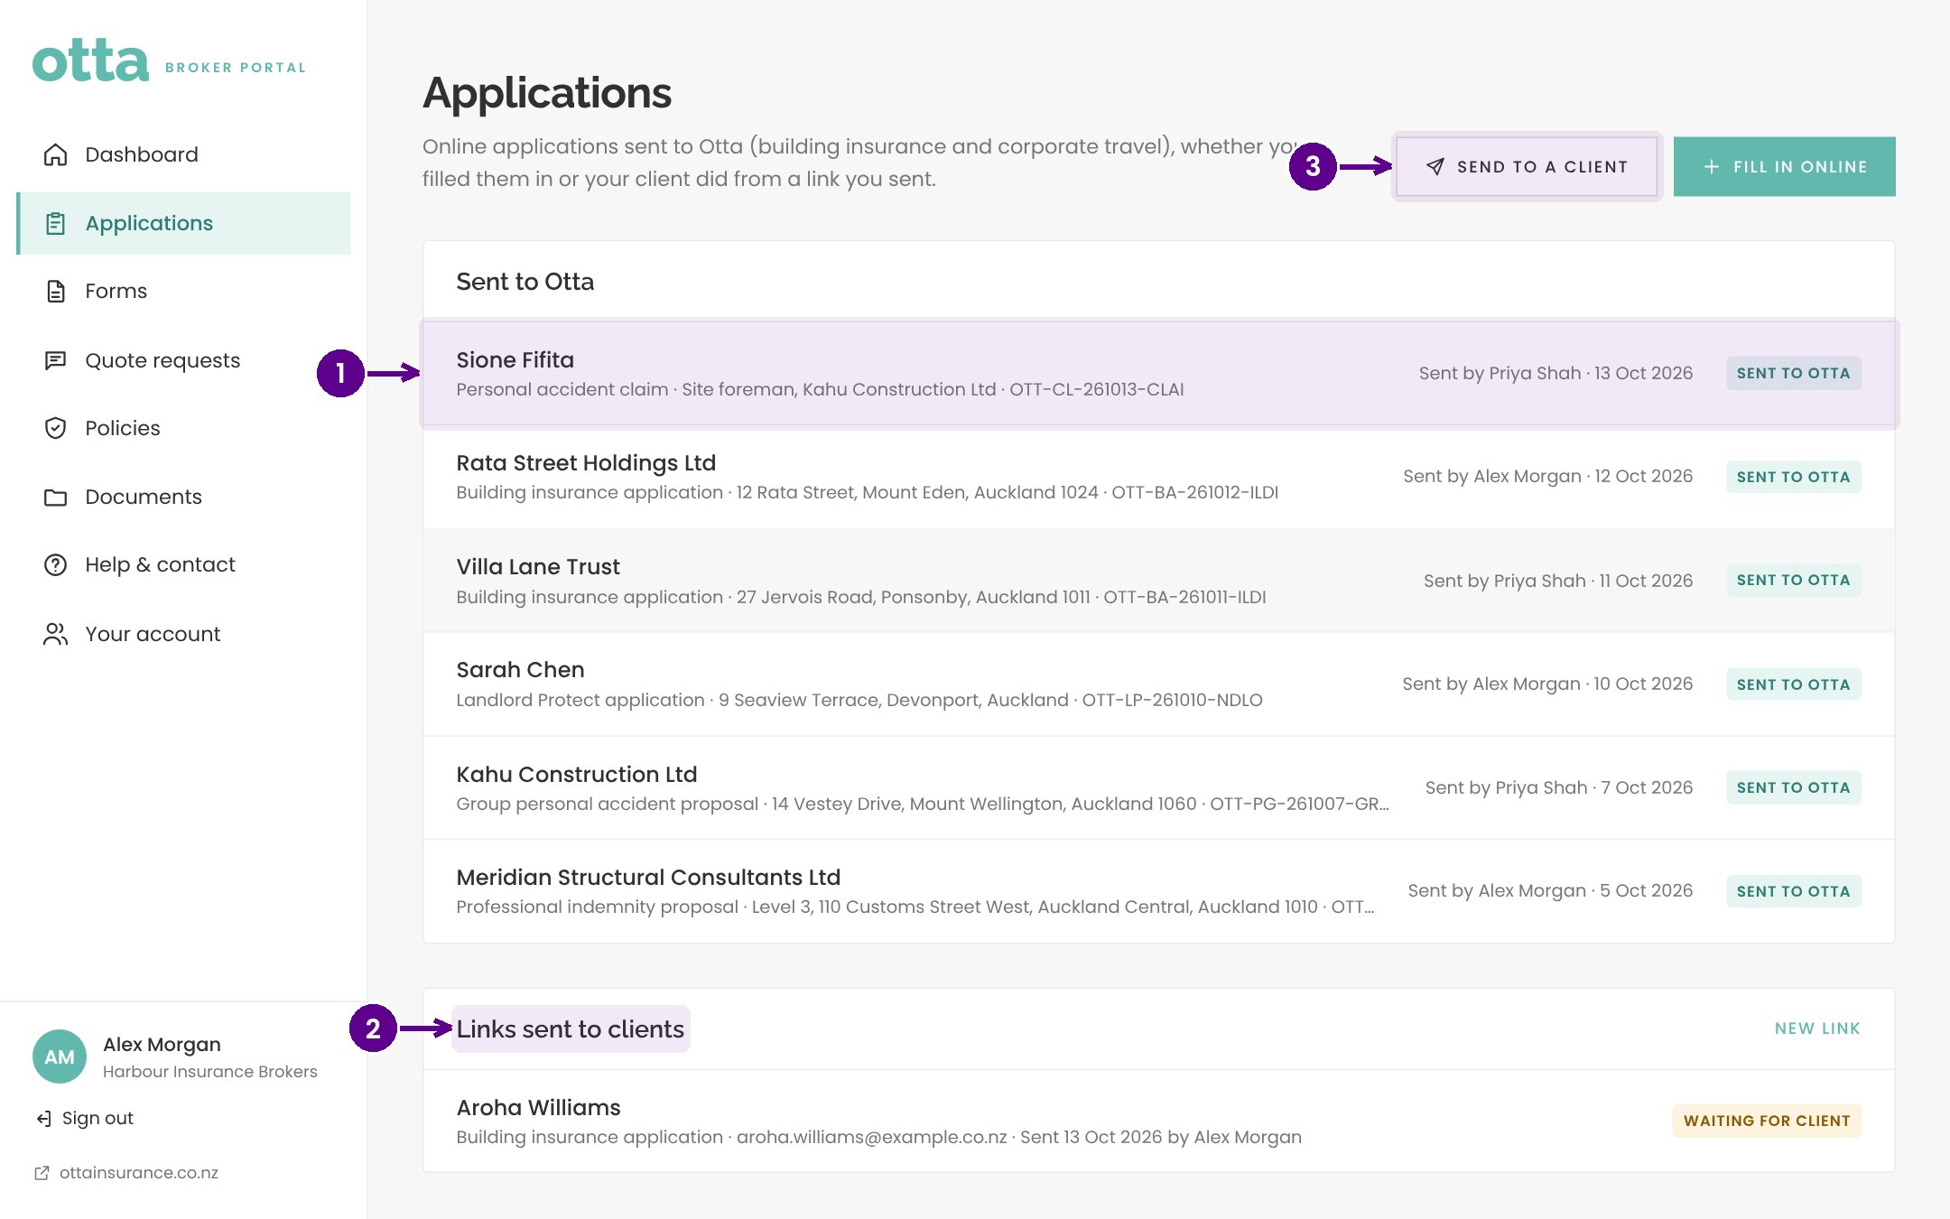
Tracking applications
1
Applications sent to Otta, by you or your clients.
2
Links sent to clients, and whether they've been completed.
3
Send to a client or fill in a new form online.
Notes:
Applications shows everything sent to Otta from the brokerage, and every link sent to clients with its status. Brokers can start a new form or send one from here too.

Slide 17
Quotes, policies and help
04
From quote to bound policy, and where to get help.
Notes:
Quotes, policies and help. From quote to bound policy, and where to get help.

Slide 18
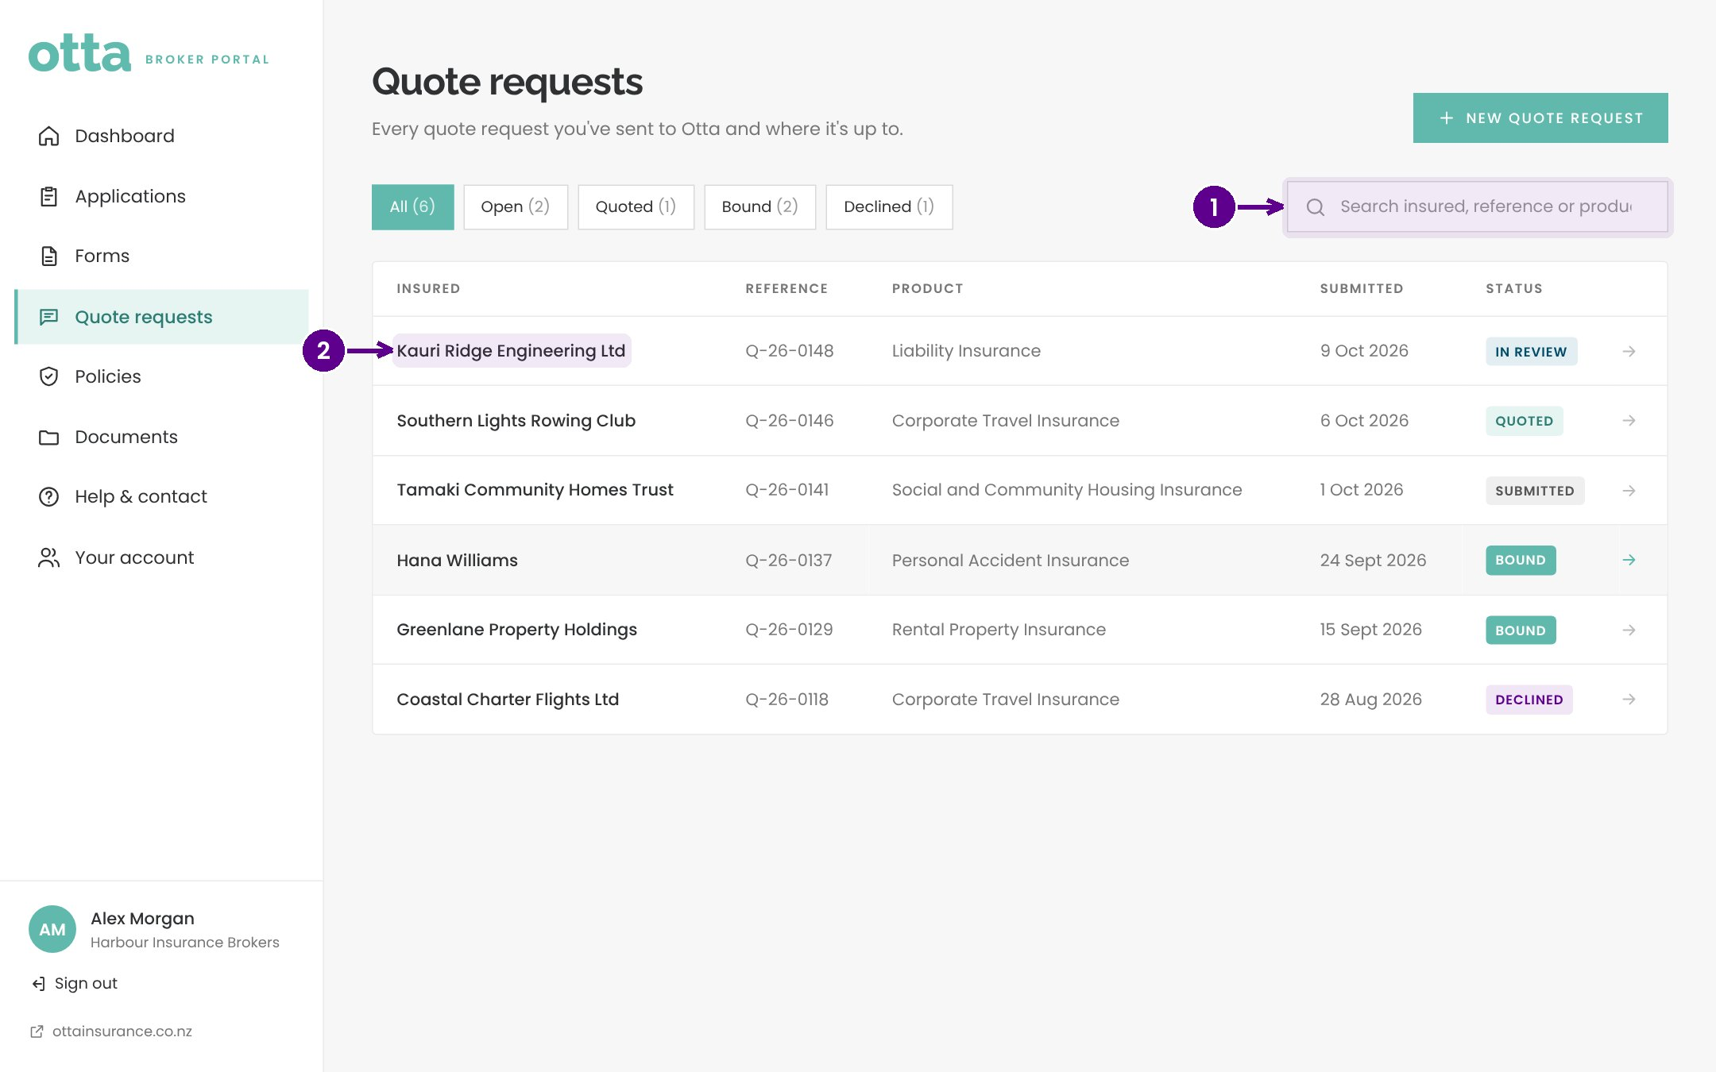
Quote requests
1
Search quote requests.
2
Select a quote to see its status and details.
Notes:
Quote requests lists every quote with its status: submitted, in review, quoted, bound and so on.

Slide 19
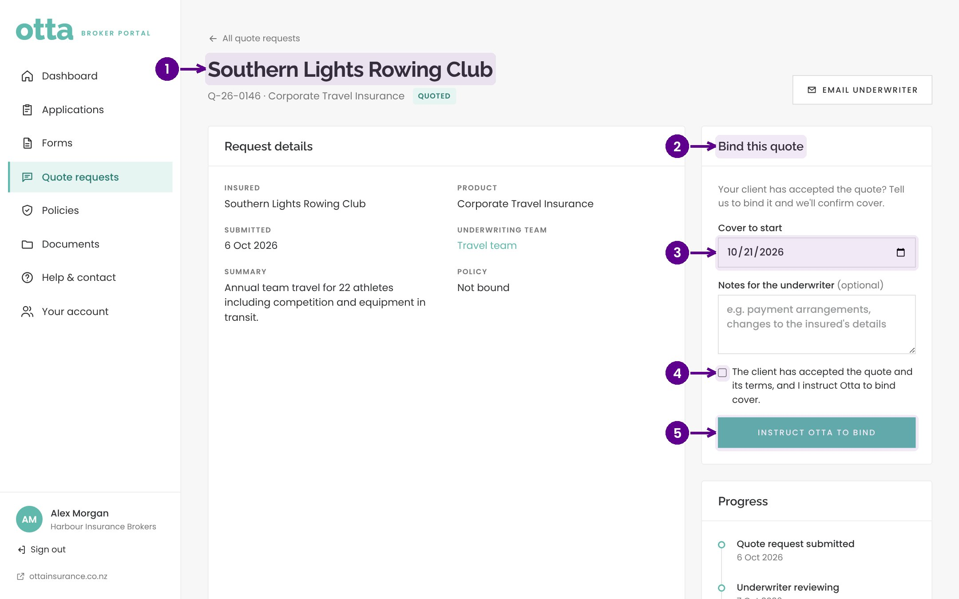
Binding a quote
1
The quote and its details.
2
Bind this quote, once the client has accepted.
3
The inception date.
4
Confirm the client has accepted the quote and terms.
5
Instruct Otta to bind. The Otta team is told straight away.
Notes:
When a quote comes back and the client accepts, the broker opens the quote and instructs Otta to bind. They choose the inception date and confirm the client has accepted. The Otta team sees the instruction immediately.

Slide 20
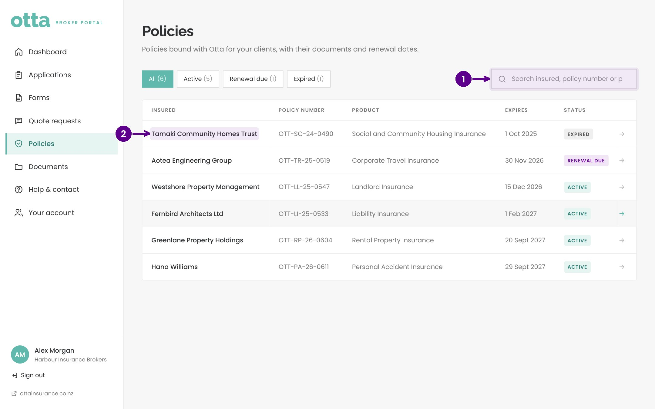
Policies
1
Search policies.
2
Select a policy to see its details and documents.
Notes:
Policies lists every policy the brokerage has with Otta, with expiry dates and renewal status.

Slide 21
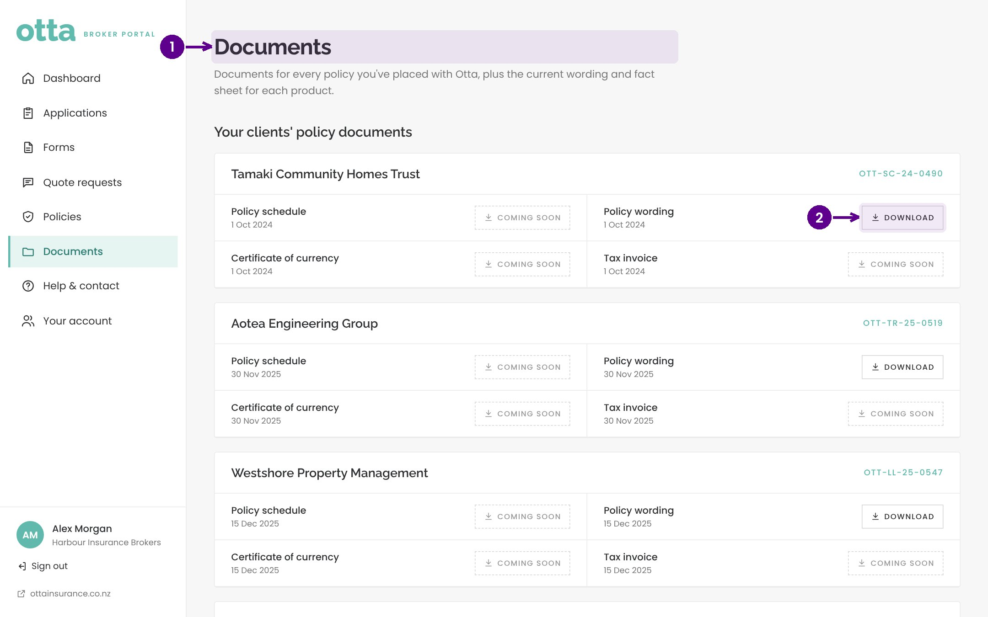
Documents
1
Policy documents for the brokerage.
2
Download any document.
Notes:
Documents holds policy schedules, wordings and other documents for the brokerage's policies.

Slide 22
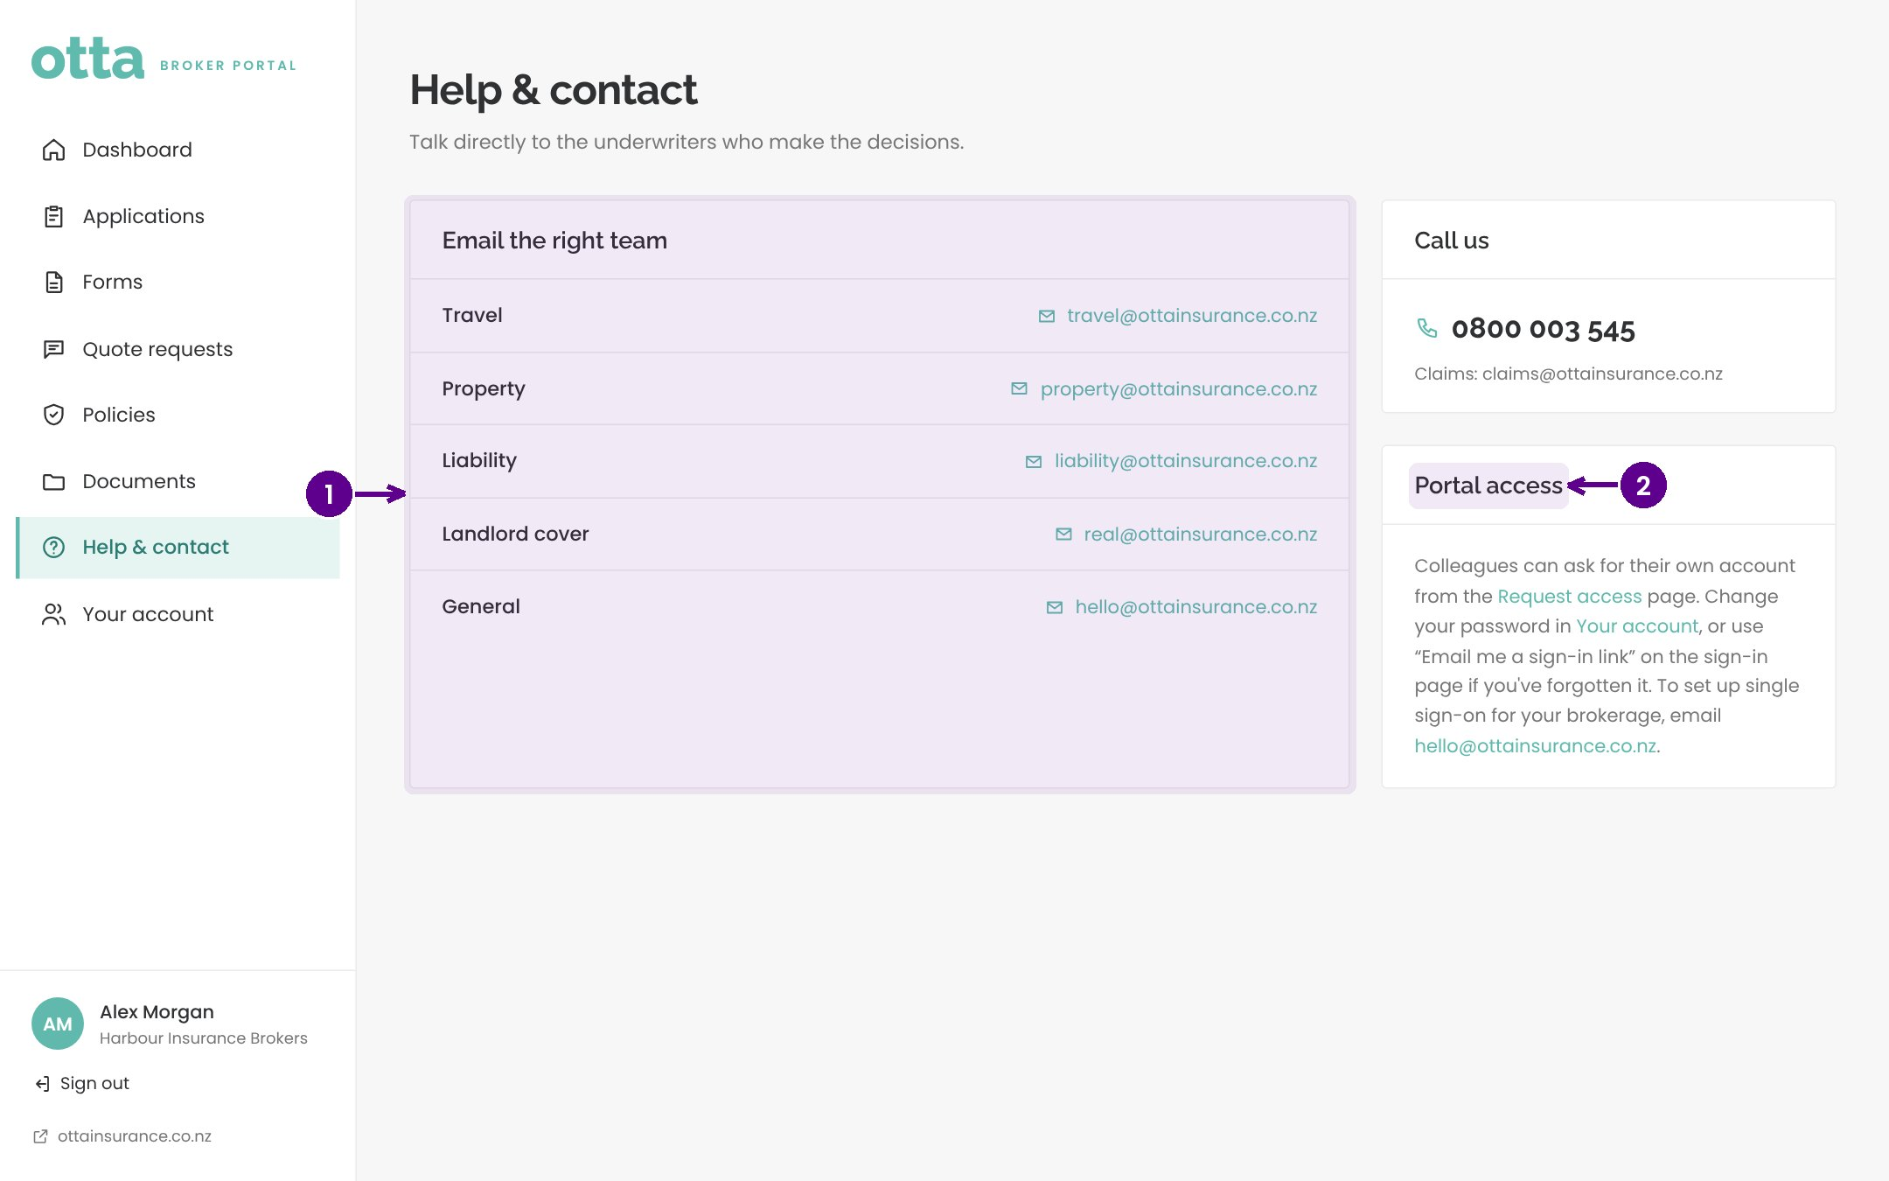
Help and contact
1
Email the right underwriting team directly.
2
How colleagues get access, and how to reset a password.
Notes:
Help and contact lists the email address for each team and our phone number. Brokers talk directly to the underwriters who make the decisions.

Slide 23
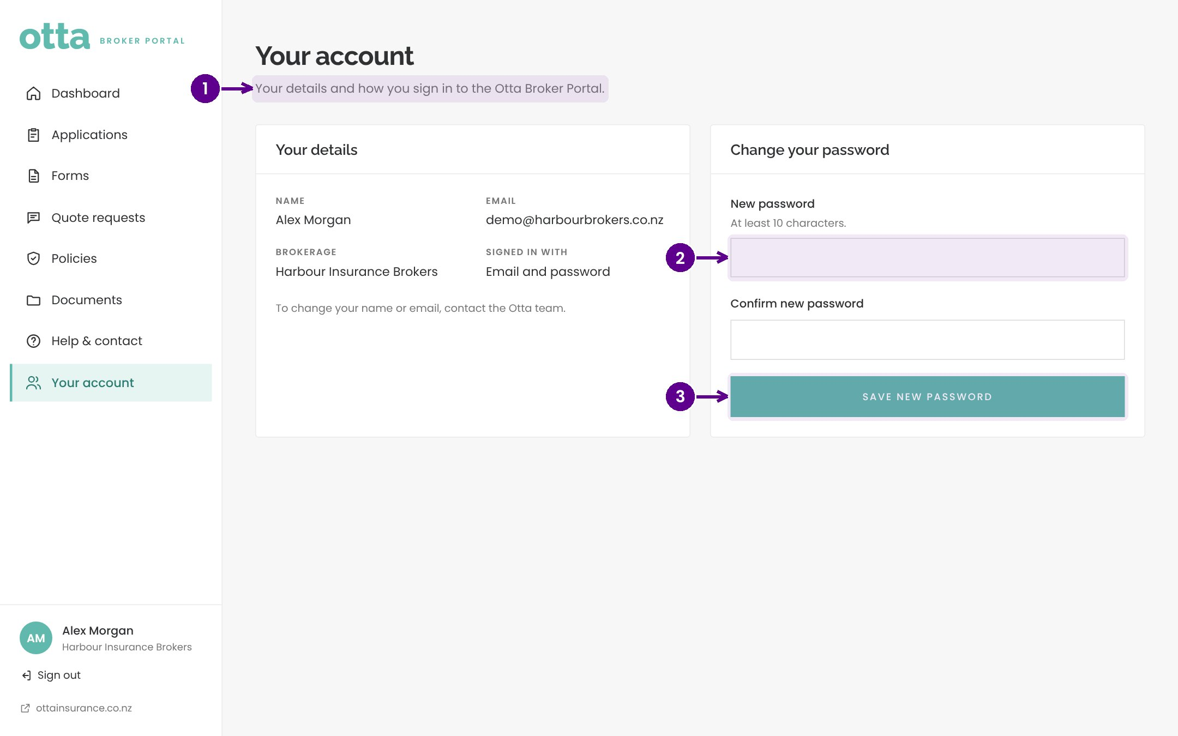
Your account
1
Your details.
2
Choose a new password.
3
Save new password.
Notes:
Your account shows the broker's details and lets them change their password.

Slide 24
Key points
Brokers request access, Otta approves, and a welcome email sets up the account.
✓
Forms can be completed online or sent to the client as a secure link.
✓
Everything submitted goes straight to Otta and shows in Applications.
✓
Accepted quotes are bound with one instruction from the quote page.
✓
Notes:
Key points. Brokers request access, Otta approves, and a welcome email sets up the account. Forms can be completed online or sent to the client as a secure link. Everything submitted goes straight to Otta and shows in Applications. Accepted quotes are bound with one instruction from the quote page.

